Slide 1


INFO5100 FINAL PROJECT PRESENTATION
Book your Tickets
A transportation management app
Peichen Han
001567041
Yiqing Wang 001563190
Leqi Wei 001561748

Slide 2

▷ Part 1 『 Introduction』
▷ Part 2 『 Features 』
『CONTENT』
▷ Part 3 『 Contributions 』
▷ Part 4 『 Sequence Diagram 』
▷ Part 5 『 Program Presentation 』

Slide 3

Part 1
『 INTRODUCTION 』

Slide 4
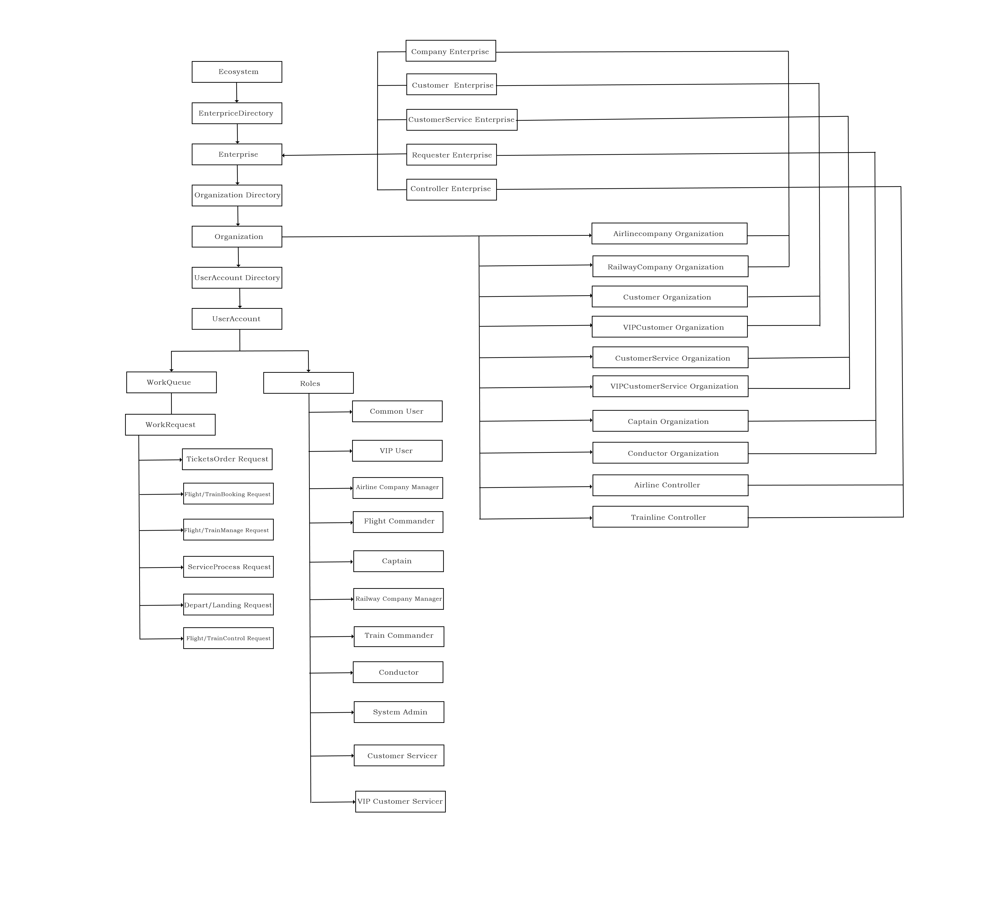
1
INTRODUCTION
We Have：
5 Enterprises
10 Organizations
11 Roles
6 WorkRequests

Slide 5
Part 2
『 Features 』

Slide 6
2
Features
For Company：
Airplane/Train Management
Airline/Railway Management
For Customer：
Buy Transportation Tickets
Manage Personal Information
Send Messages & Comments to Customer Service
Booking Personal Airplane & Train
For Customer Service：
Received Messages for Customers
Process Customers’ Request
Monitoring Booking Information

Slide 7
2
Features
For Captain：
Send Take-off/Landing Requests
For Controller：
Controls the Takeoff of aircraft
Controls the Landing of aircraft
Controls the Outbound of train
Controls the Entering of train
For Sysadmin：
User Information Management
System Data Display

Slide 8
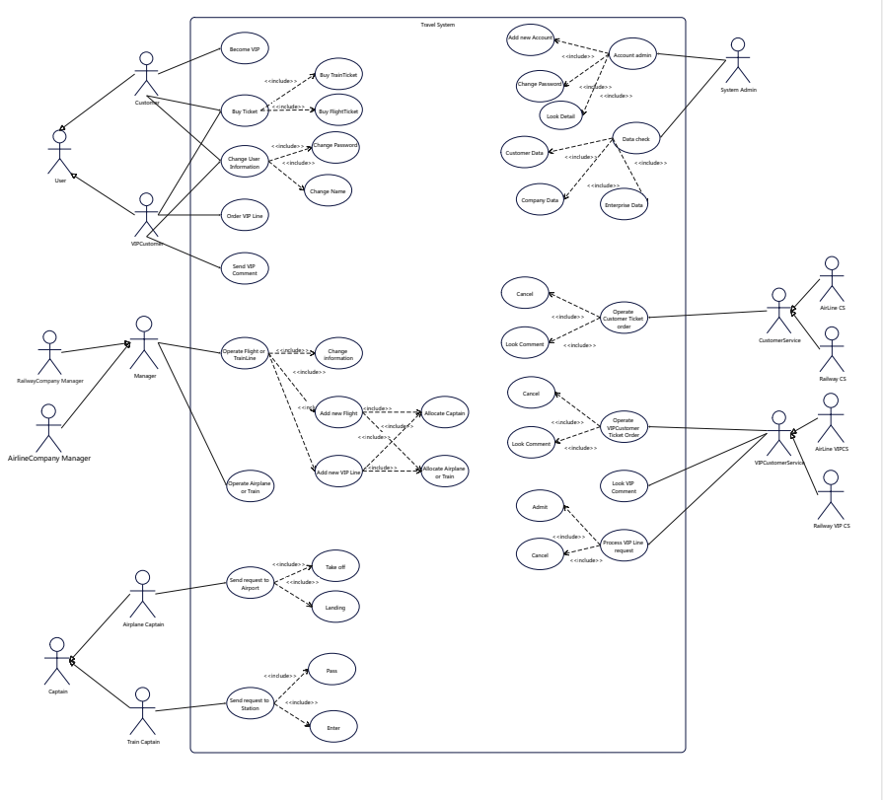
2
Features

Slide 9
Part 3
『 CONTRIBUTIONS 』

Slide 10
3
CONTRIBUTIONS
Peichen Han
Yiqing Wang
Leqi Wei
Project Structure
Login
Sysadmin Part
Customer Part
Data Display
Airline Controller Part
Railway Controller Part
Airline Captain Part
Railway Conductor Part
Company Management
（Airline & Railway）
Customer Service
(Common & VIP）
UI Design

Slide 11
Part 4
『Sequence Diagram』

Slide 12
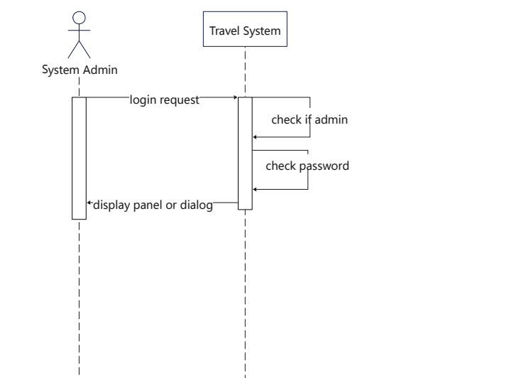
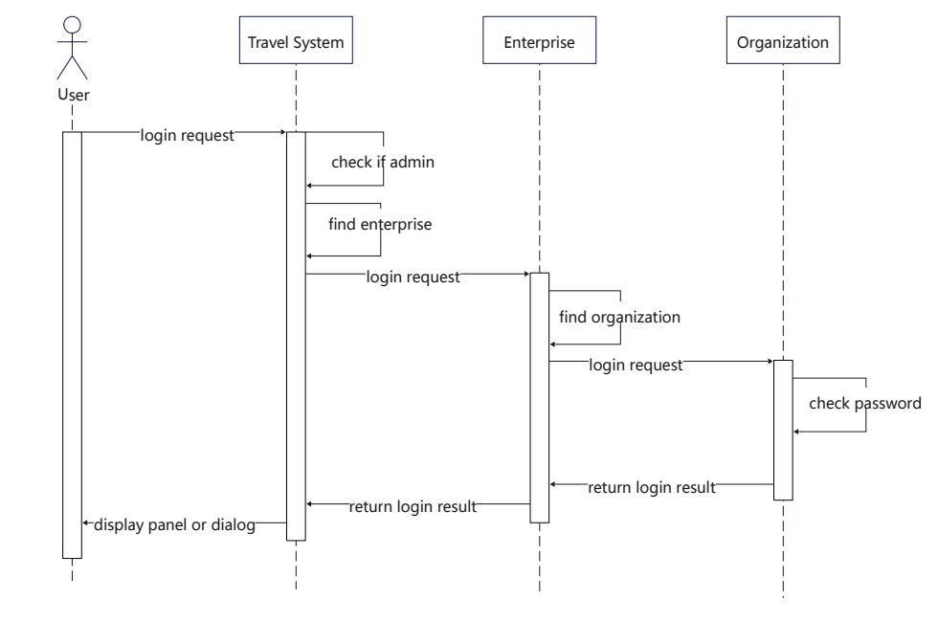
4
Sequence Diagram
Login：
Admin Login
User Login

Slide 13
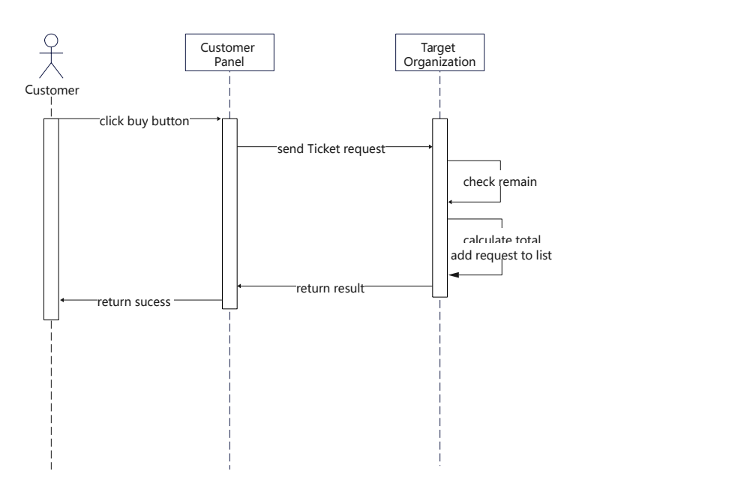
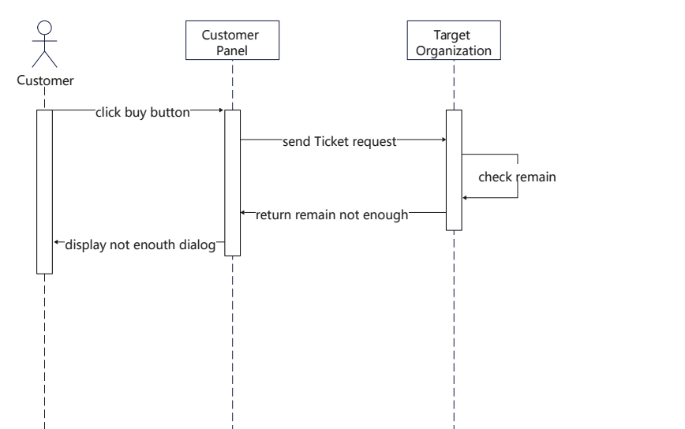
4
Sequence Diagram
Buy Tickets：
Buy Ticket Sucess
Buy Ticket fail

Slide 14
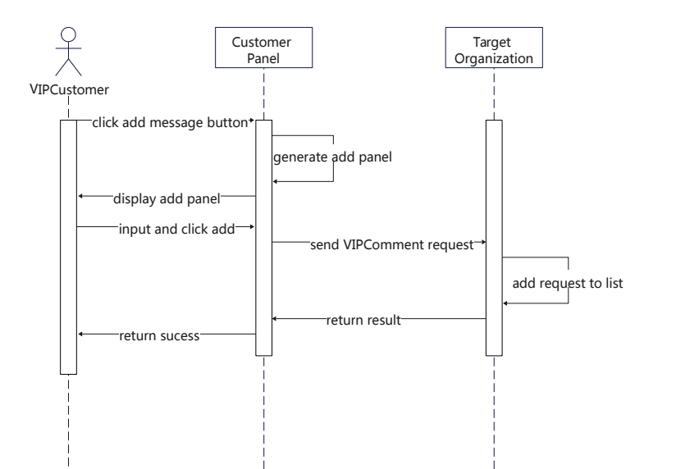
4
Sequence Diagram
VIP Comment：

Slide 15
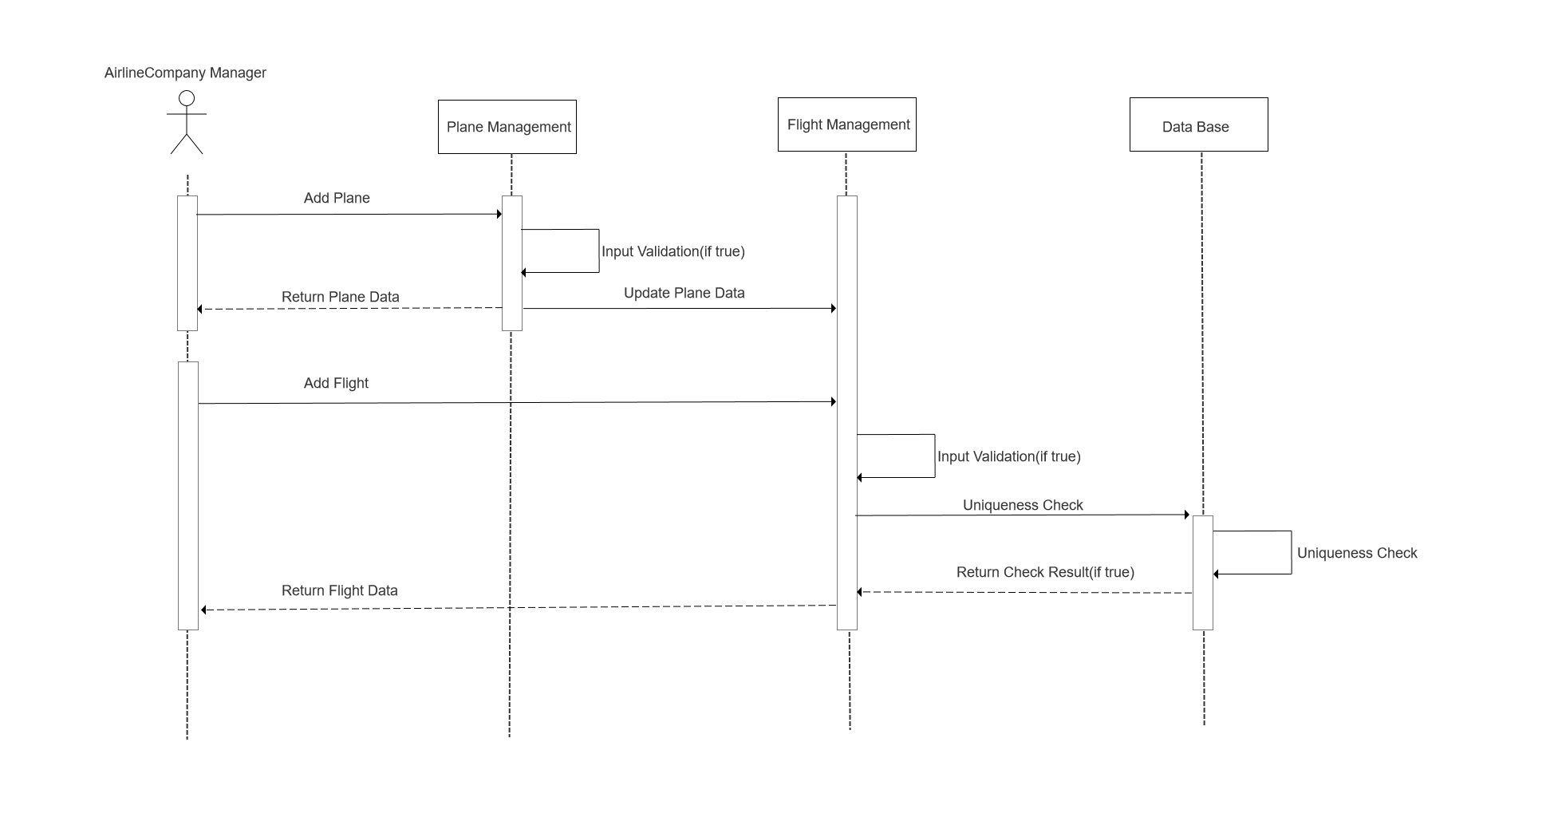
4
Sequence Diagram
Company_Management of Flight/Train：

Slide 16
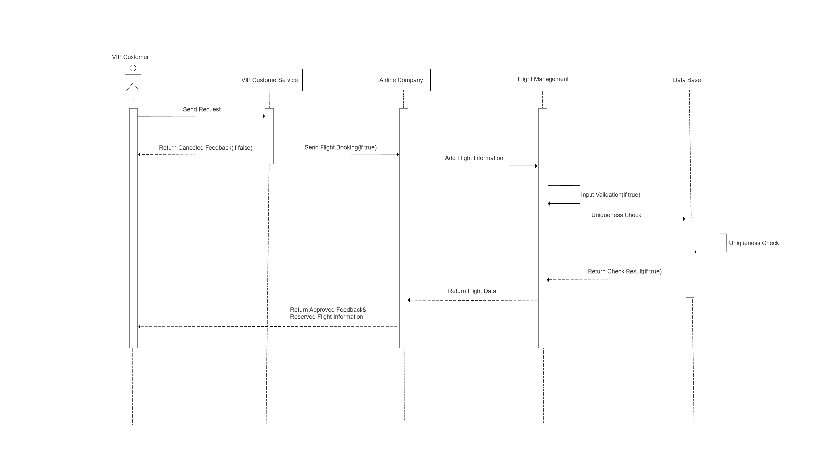
4
Sequence Diagram
Service&Company For VIPFlight：

Slide 17
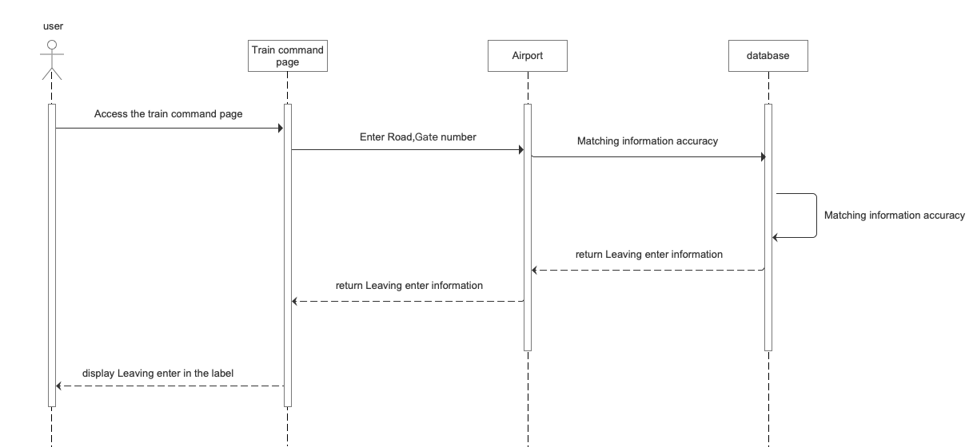
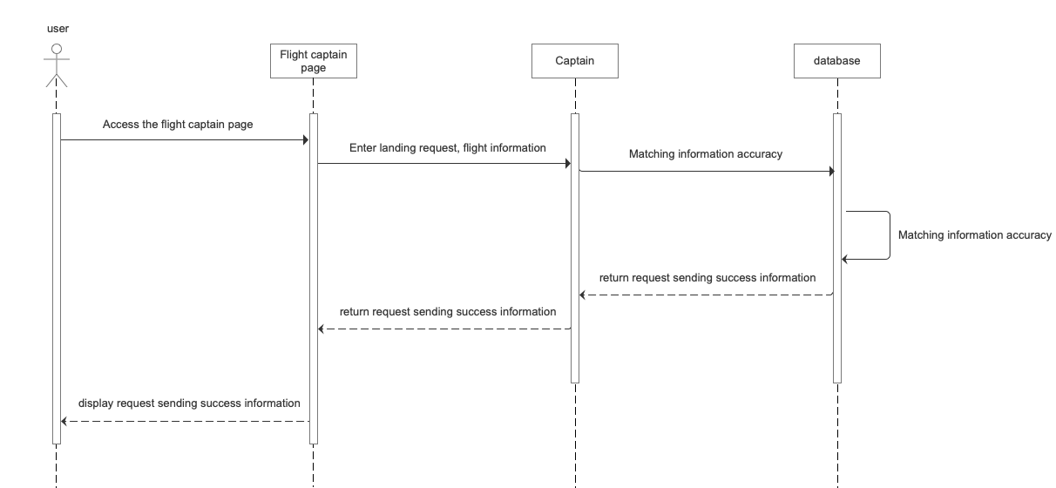
4
Sequence Diagram
Flight Leaving/Landing Request
Leaving Request
Landing Request

Slide 18

4
Sequence Diagram
Flight Leaving/Landing Control
Leaving Control
Landing Control

Slide 19


4
Sequence Diagram
Train Entering Request & Control
Entering Request
Entering Control

Slide 20
Part 5
『 Program Presentation 』

Slide 21
INFO5100 FINAL PROJECT PRESENTATION
THANK YOU !
Peichen Han
001567041
Yiqing Wang 001563190
Leqi Wei 001561748

